Slide 1

P1 Jolly Phonics Workshop
Tuesday 8th October 2019

Slide 2

Aims
Increase parents’ knowledge of Jolly Phonics (sounds/ action).
Examples of activities to support phonics at home.
Use of phonics to support reading at home.

Slide 3
Single Sounds
Sounds proceeds letter name
VAK (Visual, auditory and kinaesthetic)
Big Book
Sounds –help sheet
Positioning of sounds – initial, medial and final
Generating words
Jolly Phonics Songs https://www.youtube.com/watch?v=L9FNqmxXig4
Rhyming string
Letter formation

Slide 4
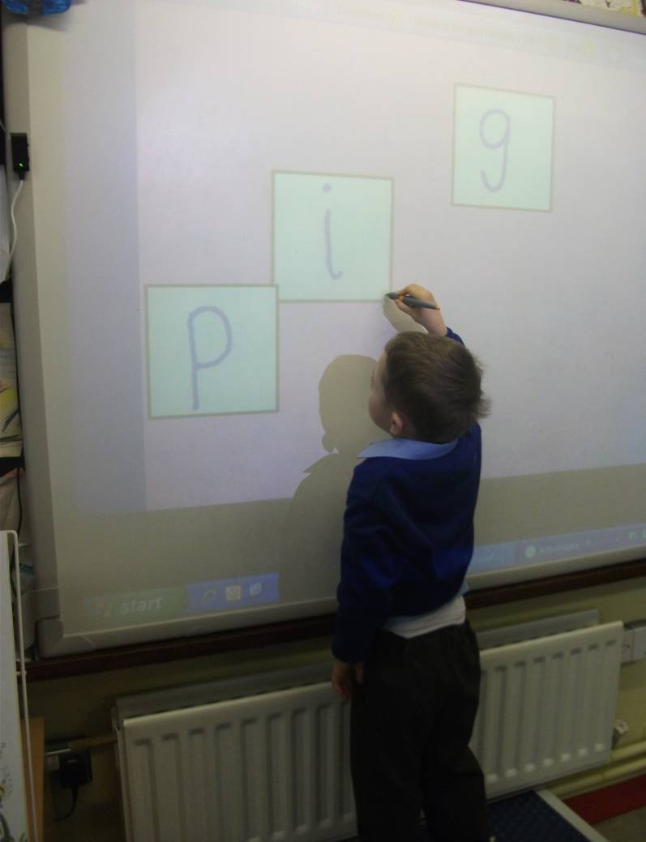
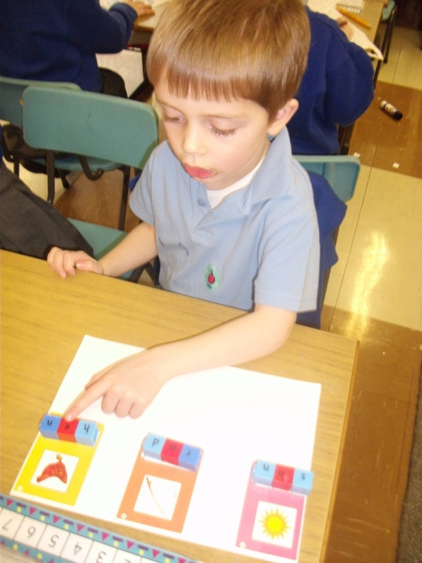
Blending
What is blending?
Blending cards
Flashcards- dots
Segmenting
E.g. “spell dog”-
child says “d-o-g”

Slide 5
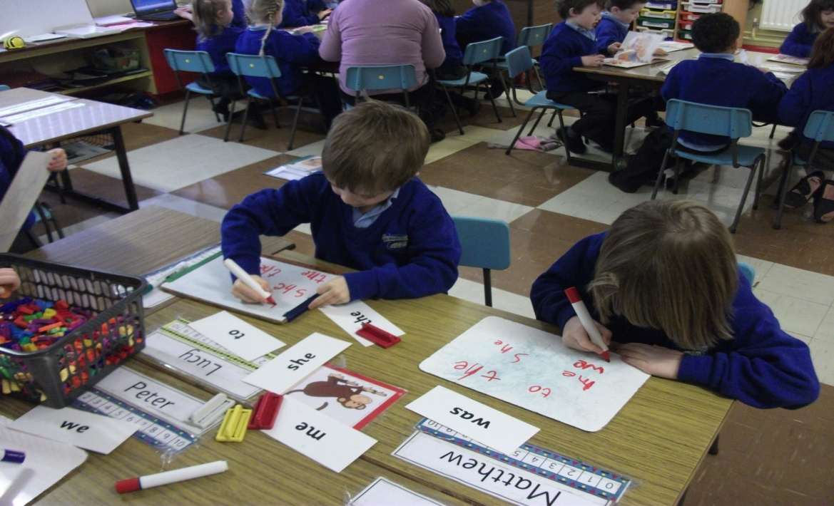
Tricky words

Slide 6
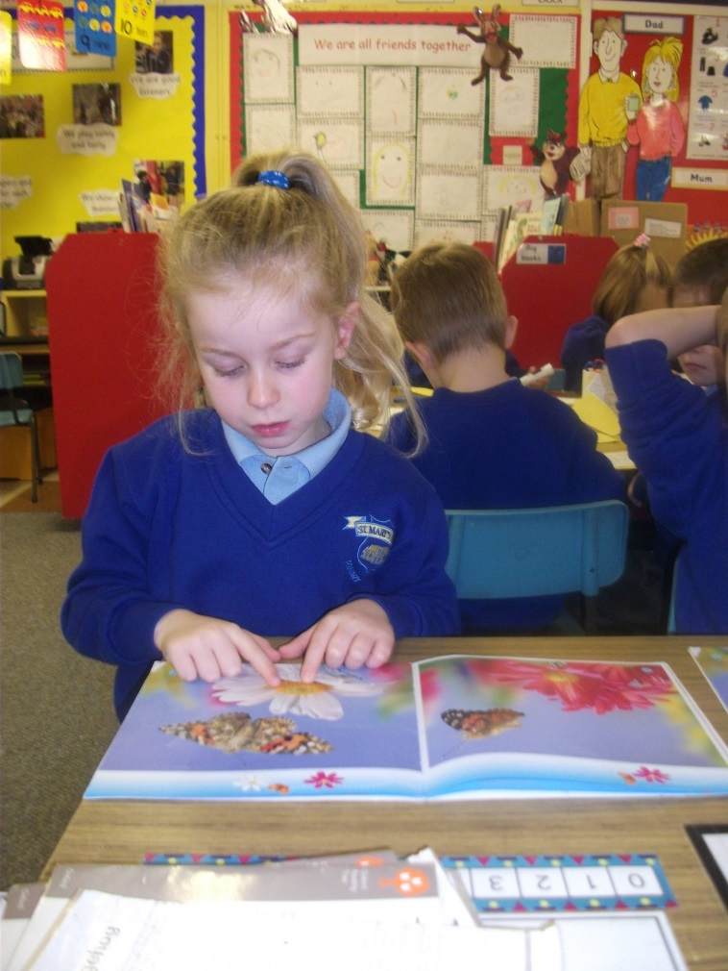
Reading
Should be fun
Key Features
Mechanics of reading
Comprehension
Culmination of skills

Slide 7
Writing
Importance of nipping pencil
Learning to write their name
Home support
Good posture
Correct letter formation- jingles
Number formation

Slide 8
Questions and evaluations
Thank you for attending

