Slide 1
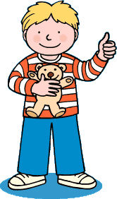
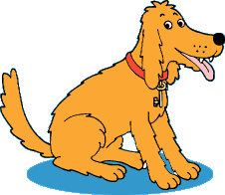
Oxford
Reading
Tree

Slide 2
I am Kipper.

Slide 3
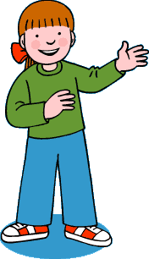
I am Biff.

Slide 4
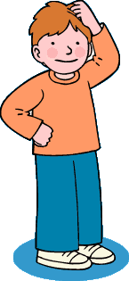
I am Chip.

Slide 5
I am Floppy.

Slide 6
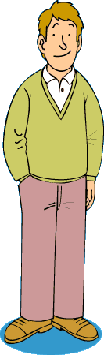
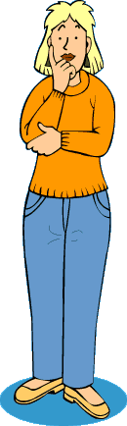
We are mum and dad.

Slide 7
Kipper
Chip
Biff
Floppy
dad

