Slide 1

P6 Curriculum Meeting
2025
Welcome Everyone!

Slide 2
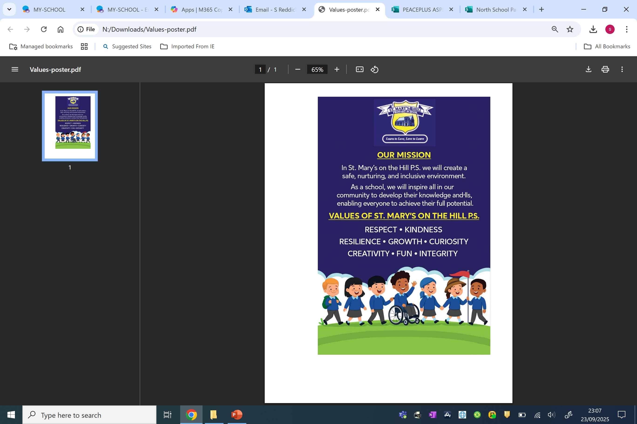

Slide 3

Curricular Areas
Literacy
Numeracy
Religion
World Around Us - History, Geography, Science
The Arts - Art, Drama, Music
P.E.
PDMU
ICT
Thinking Skills and Personal Capabilities
Notes:
Good morning everyone and welcome to the P6 Curriculum Talk. This morning our intention is to give you an overview of P6 and how we can work together to provide a happy and worthwhile year in school for your children.
I am going to start by taking you through the different curricular areas and then we will both run through how we approach these in P6.

Slide 4
Thinking Skills and Personal Capabilities
Managing Information
Thinking, Problem Solving and Decision Making
Being Creative
Self Management
Working with Others
Notes:
These skills are life-long skills that we focus on and develop in a cross-curricular way through group work and problem solving activities.
By using the thinking cards, which the children use independently, they are guided through how to approach, structure and work through an activity including how to solve any problems that may arise, including differences of opinions within the group
Within group work the children perform different roles such as manager, recorder, reporter. Each role develops a specific skill and the children rotate around these roles in order to try each one. They can review their own performance.
An other way of developing these skills is through self assessment and peer assessment which they do at the end of a piece of work or activity.
Show thinking cards

Slide 5
Literacy
Reading
Writing
Talking and
Listening

Slide 6
Numeracy
Processes in Mathematics
Number
Measures
Shape and Space
Handling Data
Notes:
In Numeracy the strands are number work, measures, shape and space and handling data.
Processes is applying the skills and strategies gathered in the other areas to solve problems.
In P6 the children use all four operations and a rapid recall of facts including the times tables are important. Speed is key.
Mental maths is an opportunity to show and explain the different strategies used to solve a problem or work out a calculation – getting the right answer is great, but being able to explain how you got that answer and knowing another way to do it is even better.
During the mental maths homework it is important to talk about strategies. The children are used to doing this in school. If you solve a problem in a different way to them – share it and vice versa.

Slide 7


Slide 8
Religion
Workbooks, DVD, music, stories, poems
Assembly – parents will be invited to attend our assembly
Mass in the class
Catholic Schools Week
Notes:
Religion is the foundation of our school ethos at SMOTH.
Fr Kerr/ Fr Pat the school chaplain is involved in school life and may visit from time to time. He encourages chn to participate in school masses through the webcam Monthly.
We work from the The Grow in Love program which forms the basis of our assemblies.

Slide 9
Geography
Science
History
World Around Us
Our themes this year will be:
Raiders and Traders
Impact
It’s a Disaster
P6 children will be taking part in Forest School for 6 weeks throughout the school year. Dates to be confirmed. With one of these sessions being a trip to Clandeboye Estate.
Notes:
WAU consists of 3 strands combined to deepen understanding of our P6 topics
Topic Based approach
Cross curricular approach
Building on previous learning
Raiders or Traders?
Impact
Extreme Weather
Forest School- Friday- Change of clothes/wellies or old shoes/raincoat and warm clothes. Parent helper????

Slide 10
Games
Gymnastics
Athletics
Dance
Swimming
        Term 1:1 PE Friday
        Swimming: P6SMC Wednesdays
        P6SR: Thursday
        P.E uniform – white t-shirt, navy shorts/ tracksuit bottoms and dark trainers.
        PLEASE LABEL WITH NAME
        Stud earrings and watch only
        For Swimming ONLY stud earrings. No other jewellery.
P.E
Notes:
Children will develop their knowledge, understanding and skills, in a range of physical activities.
All children should experience a sense of fun, enjoyment and achievement.
PE UNIFORM all items including footwear – proper footwear
This includes after schools clubs
On PE days, children should come to school in their PE gear
Hair up for PE
Swimming – no earrings. Policy of pool, need to be able to take out themselves. Hair up, hats aren’t essential but easy way of keeping hair back and dry for the rest of the day

Slide 11
TH
PDMU –
Following
School values
Anti-bullying
Positive behaviour
The Arts – Drama
Music
Art
ICT-
Garage band
Powerpoints
Coding
Animation
Notes:
Personal development and mutual understanding is a subject in which children can reflect on their choices and set themselves challenges and targets.
Each year we set up a school council.
As a school we have high expectations of behaviour and clear consequences of inappropriate behaviour. We use our positive behaviour policy which you will be able to access on the website.
In class we foster positive behaviour through the our targets, reward system and Pupil of the Month.

Slide 12


Slide 13
Homework
Monday – Thursday (Parents should sign completed homework)
  Spellings – Mon, Tues, Wed (Look, Say …..) Thursday - revise.
  Numeracy and Literacy focused sheet due Thursday
  Numeracy and Literacy Skills due each day
  Reading each night- Record in Reading Records
  Approx. 1 hour plus reading
Notes:
We have an agreed routine within our year group.
Spellings
Mental Maths Focus -Tables - at the minute, Moving onto Prime no /Sq no etc
Written task – Numeracy literacy
Reading very important
H/wk last one hour- additional time for reading
You can support your child by
Helping to develop independence – remembering Google classroom homework, managing time, working around clubs
Encouraging your child- To do their best/work on handwriting and presentation
Checking and sign homework- Any problems let us know
Ask chn to check over work for spelling /calculation errors

Slide 14
Assessment
On-going observation/ correction of work/ class assessments.
Weekly spelling and mental maths tests **Please Sign**
End of topic\term tests.
Results are used to inform future teaching and learning.
Standardised tests used to inform future planning and direct learning.
Notes:
Emphasis is on improvement raising achievement in pupil’s learning and to celebrate success
Pupils use WALT and WILF
Self / Peer Assessment
2 Stars and a wish
Set personal Targets
CAT – October
Standardized PTM/PTE-In May

Slide 15

Seesaw
Seesaw will still be used as a means of sharing information and photos. Parents/carers can no longer message the teacher on the seesaw platform.
Urgent messages for the teacher will need to go through the office.
Communications on Seesaw should be treated confidentially and should not shared on any other platforms.
Notes:
Contact school office
Encourage children to independently manage their learning – rather than sending messages on Seesaw we will encourage the children to carry small messages home and back verbally.

Slide 16
PTA
Always looking for new members
We encourage support of the association
Organise events throughout the year such as the school discos
Healthy Eating Policy
Thank you for your support
We would encourage a piece of fruit/vegetable/yoghurt/cheese/sandwich with water/ milk for break- 15 mins
Water bottle for throughout the day (reusable bottles please)
Try to extend the healthy eating into lunches
Notes:
Remember Nut free Zone

Slide 17
House Keeping
Contact details – please ensure these are kept up to date. Inform office of any changes
Absences – should be explained by a note to the teacher or a phone call
If you have to take children out of school early, you must sign child out at office and they will be sent for
Car Park Safety
Drop off time is 8.45am, there is no supervision until this time. Children arriving after 9.00am will be marked late and should be brought to the office.
No return to classroom after being dismissed
Notes:
Contact details – Let office know if there are any changes
Absences-We need to record a reason in the register, please provide a reason via office, Seesaw or note.
Use of sign out system to take your chn out early
Car Park Safety - We ask that you park in parking bays – preferably reverse parking. Please try not to block in other drivers and do not drop off at the gate as this has a knock on effect on Carnmoney Road.
If using the Drop Off Zone, can you ensure that children exit vehicle from left hand side only.
Punctuality is essential as children are missing the first lesson and can disrupt other coming in late. If they are marked late this means they are absent for the whole morning and this will affect their attendance.
No return in the interest of health and safety- not supervised

Slide 18
  Dinners –School Money
  Uniforms – Full school uniform everyday, including BLACK shoes
  No Jewellery except watch and stud earrings
  Label all items
  Mobile phones – Google form permission
  Prompt return of permission slips/reply slips on School Money
  Keep teachers informed of any medical needs
  Only essential medicine to be brought to the office before 9am and a permission slip to be completed
  Parent/Teacher interviews will take place week beginning Monday 24th November to Friday 28th November – School Closed to pupils on Friday.
Notes:
Dinners school money
Pupils participating in afterschools sports activities must wear school PE uniform. Label jumpers
Children who want to take a mobile – Google forms – if your child gets a phone for Christmas then you will need to send written permission
Children also require permission to walk home – indicated on Google Form – written if this changes throughout the year
Prompt reply of permission slips – like swimming/trip
If your child requires essential medication during the school day consent form (available from the school office) must be completed and left at the school office along with the medication.
Eco School- Rather than give copy of curr booklet to all parents – available on the website
If you don’t have access school will provide.

Slide 19


