Slide 1

Primary Five
Please sign in!

Slide 2
Primary Five
Curriculum Talk 2025

Slide 3


Slide 4
N.I. Curricular Areas
Literacy
Numeracy
ICT
Religion
World Around Us - History, Geography, Science
The Arts - Art, Drama, Music
P.E.
PDMU
Thinking Skills and Personal Capabilities
Notes:
Good morning everyone and welcome to the P5 Curriculum Talk. I am Miss Courtney and this is Mrs Dempsey and we are the P5 teachers. This morning our intention is to give you an overview of P5 and how we can work together to provide a happy and productive year in school for your children.
I am going to start by taking you through the different curricular areas and then we will run through how we approach these in P5.
READ CURRICULAR AREAS
ICT permeates all areas and the children's understanding is enriched and developed through the use of ICT such as apps on the iPads or presenting work they have researched independently or in a group in topic work

Slide 5
Literacy
Reading
Writing
Talking and
Listening
Notes:
There are 3 elements to Literacy and we aim to help the children develop skills across all 3 areas.

Slide 6
Writing
Independent, modelled and shared writing
Different genres – recount, narrative, explanation, persuasive, reports
Grammar and punctuation – apply the skills!
Cross curricular writing
Handwriting and Spelling Scheme
Talking and Listening
Topic work discussion
Thinking skills and group work
Presentations
Notes:
As you can see from the slide we have a structured approach to teaching writing. The children will have the opportunity to see us modelling the different forms of writing and will be involved in creating shared pieces. Lessons are often linked to our topic amd our class novel. We take a genre and explore the features and over a series of weeks we work towards the children producing their own piece of writing. In P5 we expect the children to draft and edit to improve their work. On the slide you can see the different genres we will be covering over the course of this year.
We are always promoting cursive writing as it aids with spelling and fluency. At this stage we are expecting the children’s writing to be correctly formed and evenly sized and spaced. We are also encouraging good presentation of their written work.
The spelling programme we are following focuses on a spelling pattern or rule and high frequency words. We encourage the use of L S C W C to help children practice their daily spellings.
The children are given the opportunity to develop their talking and listening skills through topic discussions and drama activities and have a chance over the year to be involved in a range of presentations.
While encouraging the development of good listening skills in the children, we often talk to them about listening bodies- their body is turned towards the speaker. This is also reinforcing our school values of respect.

Slide 7
Reading
  Range of approaches used in teaching reading – small group guided/ whole class guided/ shared reading
  Guided Readers – pitched at your child’s individual level
  Home readers should be pitched at the level of the individual, your child should be able to select books they are able to read independently
  Accelerated Reader Quizzes will be taken on texts, where available
Notes:
We teach reading through a combination of small group guided sessions and whole class or group guided and shared reading. Guided reading refers to lessons where we lead the children through the book, looking at characters, setting, the authors use of language etc. The children will also be encouraged to develop a range of comprehension skills through reading lessons. They will work on simple retrieval of information from the text as well as working on prediction and reading between the lines and so on. Reading Quadrant and VIPERS
Independent readers are recorded in the page provided at the back of spelling book. These extra readers can be from home or the class library. The Glengormley library here is also a great resource for the children. The extra readers are purely for enjoyment for the children and to help foster in them a love of books. Accelerated Reader is a resource you are hopefully well familiar with now. It is a great motivator for the children to read. Children should be achieving 85% or higher in the quizzes they take.

Slide 8
Numeracy
• Processes in Mathematics
• Number
• Measures
• Shape and Space
• Handling Data
Notes:
In Numeracy the strands are number work, measures, shape and space and handling data. Processes is applying the skills and strategies gathered in the other areas to solve problems.
In P5 the children use all four operations and a rapid recall of number bonds and the times tables are imperative not just for speed but also for accuracy.
Mental maths is an opportunity to show and explain the different strategies used to solve a problem or work out a calculation – getting the right answer is great, but being able to explain how you got that answer and knowing another way to do it is even better. Four grid.
During the mental maths homeworks it is important to talk about strategies like starting with the biggest number, or making pairs to 10, or using doubles or near doubles. These are just a few examples of some of the strategies that the children use.

Slide 9
Focus
Independent, group and paired activities
Practical work and interactive whiteboard
Times tables
Four operations
Star Maths and Freckle
Problem solving strategies for example Bar Modelling/Inverse Operations
Four Square
Notes:
This slide shows the different approaches used when we are teaching Maths.
The bar modelling mentioned on the slide refers to one of the strategies we encourage the children to use in problem solving. It is basically a visual representation of the information given in the problem the children are attempting to solve. FORWARD TO NEXT SLIDE
It will be one of the strategies we will focus on but there is a wide range of strategies we teach such as Make a list, simplify the problem, act it out, draw it out to name a few.
BACK TO SLIDE
We have already made a start on helping the children learn the times tables. We place a lot of emphasis on the need to really know the tables in P5 as they are key to so many other aspects of maths. We are spending 2 weeks on each set of tables and we would expect the children to rote learn them as best they can.
Doodle maths is a really valuable resource for the children. They can access their doodle accounts on the ipad or lap top. It is a fun , interactive way for the children to engage with a wide range of maths topics such as the times tables, shape and measures. The children will have the chance in class to use Doodle but we are also expecting them to complete assignments as part of their homework each week.
Mental maths is an opportunity to show and explain the different strategies used to solve a problem or work out a calculation – getting the right answer is great, but being able to explain how you got that answer and knowing another way to do it is even better.

Slide 10

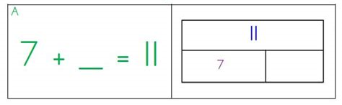
Problem-solving
An important part of Numeracy is equipping children with the strategies they need to solve problems
We are also looking at specific strategies for solving problems such as:
  Make an organised list Make a table Make the problem simpler Bar Modelling

Slide 11


Slide 12
Religion
Chaplain Fr. Pat Sheehan
Grow in Love
Assembly
Mass in the Class
Catholic Schools Week
Carol Service
Notes:
Class masses via webcam. Let you know the dates in case want to join through parish website. (Last Tuesday each month)
We work from the Grow in Love scheme which forms the basis of our assemblies.
No Sacraments this year but Carol Service in December TBC
Through this programme we learn about the life of Jesus through songs, poems and stories.
Catholic School’s Week is end Jan, beginning Feb

Slide 13
The Arts
Music
Art
Drama
Notes:
Moving on to the Arts. As you can see it is split up into three strands.

Slide 14
The Arts
Drama
Hot seating
Conscience alley
Improvisation
Assemblies
Carol service
Music
Music express
Grow in Love
Specialist teachers
Hymn practices
Art
Appreciate the work of an artist
Develop skills through discrete classes
Notes:
For The Arts we have discrete lessons as well as being taught in a cross curricular way through topic work.
We have a music programme called Music Express.
We do a lot of the Arts through topic work for example in Term 3 our Topic is Magnificent Machines and we read a class novel linked to this called Iron Man. This lends itself really well to drama, music and art where we make junk art of Iron Man. This was one of their favourite activities last year. Through our Water Water Everywhere topic in Term 2 we look at art techniques such as pointillism where we create Titanic artwork through dots.

Slide 15
PE
Children will develop their knowledge, understanding and skills, in a range of physical activities.
All children should experience a sense of fun, enjoyment and achievement.
Games Mindfulness Athletics
Boxing Swimming Dance
P5MD – Monday and Thursday P5EC – Monday and Thursday
P.E uniform – white t-shirt, navy shorts and black trainers, please label with name **No jewellery. Stud earrings and watch only **
Notes:
Children are asked to wear their PE uniform on the days that they have PE.
PE uniform is expected to be worn at Afterschools clubs so also come in in PE gear on these days.
We have a coach at the minute for mindfulness. Swimming is in Term 3. Avoid ear piercing.
In the third term, after Easter, P5 will begin swimming . The pool have a policy that no earrings are worn bear this in mind is hetting ears pierced. The childnre need to be able to take the earrings out t themselves. On swimming days, we would encourage that long hair is tied up, hats aren’t essential but easy way of keeping hair back and dry for the rest of the day

Slide 16
World Around Us
An awareness of themselves and their place in the world, as well as of other places, cultures and the environment.
Geography
Science
History
Notes:
WAU consists of 3 strands combined to deepen understanding of our P5 topics
We combine discrete lessons with activity based learning which follows on from PBL p1-4

Slide 17
World Around Us
Topic Based approach
Cross curricular approach
Building on previous learning
Raiders of the Lost Tomb
Water, Water Everywhere
Magnificent Machines
Notes:
Our topics are Raiders of the Lost Tomb where we study Life in Egyptian Times, Water, Water, Everywhere and Magnificent Machines.
We encompass history, geography and science through these topics. Some are more science heavy, geography heavy or history heavy but this balances itself out. We also ensure that we cross these topics over into different areas of the curriculum such as ICT where we do
Research and create a powerpoint on Raiders of the Lost Tomb or Numeracy where we look at survival statistics on the Titanic in relation to class, gender and age.

Slide 18
PDMU
Making good choices
Linked to positive behaviour policy Focus for September
ACTIVE LISTENING
School and class council
P4 – P7 involved in a series of lessons to build up to the launch of our School Council. We hope to have two representatives from each class who will attend monthly meetings and address issues in the school.
Anti-bullying week
Week devoted to identifying strategies to combat bullying
Notes:
Personal development and mutual understanding is a subject in which children can reflect on their choices and achievements and set themselves challenges and targets.
School behaviour target in September is Listening – listening eyes, mouth and body.
Personal Development and Mutual Understanding
We start off in Primary 5 with a class plan for learning. This is a way for the children to help establish the type of classroom they would like to be in. My class came up with great ideas such as a loving classroom, comfortable, inspiring, hard working and when they voted the final decision was that when they came into class they wanted to feel safe, included and they wanted the classroom environment to be calm so that they could learn. We also looked at rights and responsibilities. Right to go to the toilet means we have to flush, dry our hands, not misuse the toilet pass. Right to drink water in class means the responsibility to not drink whilst I’m teaching and not flip water bottle.The right to feel included means we have the responsibility to be kind and include others. The children have now created their own code of conduct and this also leads to discussion on how to prevent bullying behaviour.
As well as this we look at setting up a school council . Every child will be given the opportunity to put themselves forward. This year Plants in classrooms.
As a school we have high expectations of behaviour and we use our positive behaviour policy which you will be able to access on the website.
In class we foster positive behaviour through the our targets, star of the week, the use of class helpers, positive praise ,class stars

Slide 19
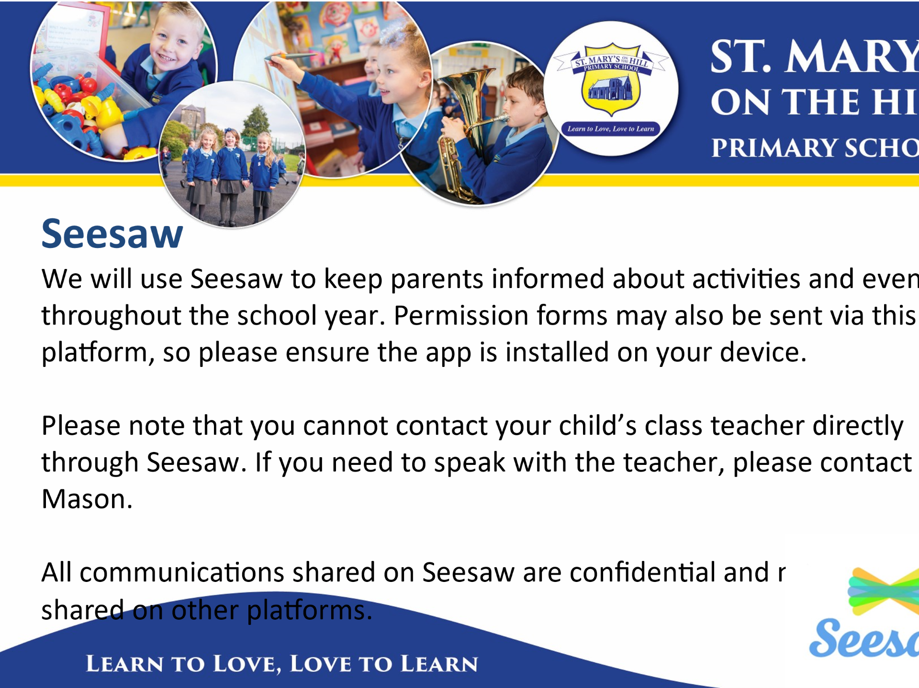

Slide 20
ICT
-Keyboard and word processing skills
-Using digital media
-Cross-curricular skills such as reading for research
- Green Screen
- Coding
-At home, children can create their own PowerPoint presentations and carry out their own research to share with the class
-E-Safety
Notes:
ICT permeates all areas and the children's understanding is enriched and developed through the use of ICT such as apps on the iPads or presenting work they have researched independently or in a group in topic work.
We teach stand alone lessons in our ICT suite or class set of iPads. Through these lessons the children develop: above
Just to remind you, the children can log in to my school at home, using their personal login details. Here they can access my links, which gives them access to different apps.(see above)
Google Classroom see homeworks and other information.

Slide 21
Thinking Skills & Personal Capabilities
Managing information
Thinking problem solving and decision making
Being creative
Self management
Working with others
Notes:
These skills are life-long skills that we focus on and develop in a cross-curricular way through group work ( diff ability groups/ same interest groups) and problem solving activities. Important for real life situations.
The children are guided through tasks to examine how to approach, structure and work through an activity. They will try to solve any problems that may arise, including differences of opinions within the group.
Within group work the children perform different roles such as manager, recorder, reporter. Each role develops a specific skill and the children rotate around these roles in order to try each one.
They will also develop these skills through self assessment and peer assessment.

Slide 22
Homework
Monday – Thursday
  Spellings – Mon, Tues, Wed record in book. Thursday revise.
  Mental maths and literacy/ Numeracy skills daily
  Reading – guided and independent
  Comprehension
  Other homework – given on a Friday and to returned on a Friday
  Google Classroom
  *Independence* and approx. 45 mins
  Please sign Friday tests & look at any corrections to help reinforce learning
Notes:
We have an agreed routine within our year group.
Overview on Google classroom on every Monday.
Spellings – expect 10/10
Mental Maths Focus -Tables
Written task – Numeracy literacy skills/ Maths sheet/Comprehension.
Reading very important
H/wk 45 mins- additional time for reading
You can support your child by
Helping to develop independence.
Have a break. Quiet area. Be organized.
Encouraging your child- To do their best
Checking and sign homework- Reinforcement of work done in class.
Any problems let us know -we can gauge and adjust accordingly.
Progress will be reflected in the work the children do in class, weekly and in their tests to show they can apply the literacy skills, spelling rules and mental maths.

Slide 23
Assessment
On-going observation/ correction of work/ class Assessments.
Weekly spelling and mental maths tests **Please Sign**
Results are used to inform teachers for future teaching and learning.
Standardised tests used to inform future planning and direct learning.
Notes:
Emphasis is on – improvement/ raising achievement in pupil’s learning /and celebrate success
Pupils use WALT and WILF
Self / Peer Assessment
Traffic Lights
Set personal Targets
Standardized PTM/PTE-In May
Read from the screen

Slide 24
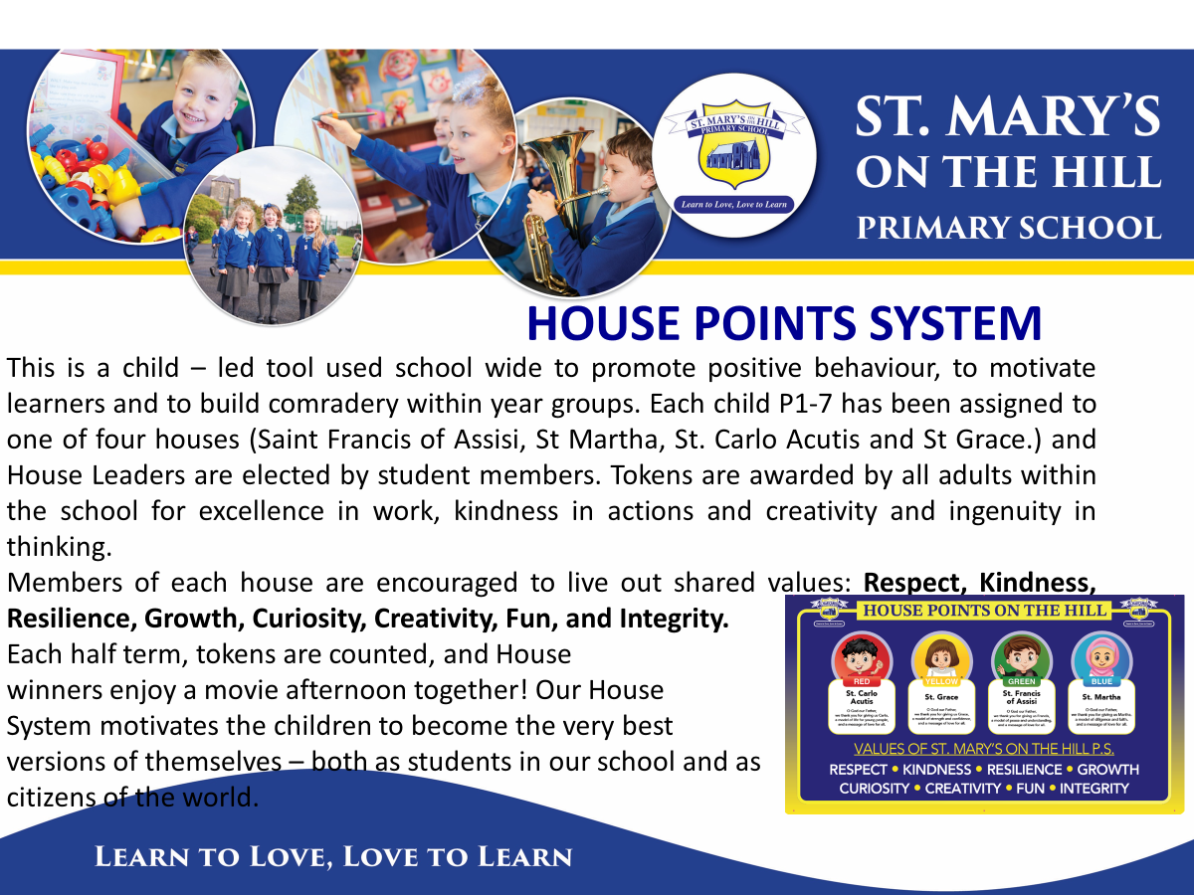

Slide 25
PTA
Always looking for new members and assistance
As a school we encourage support of the association
Organise events throughout the year such as the school discos
Provide funding e.g. ICT equipment
Healthy Eating Policy
Thank you for supporting this
We would encourage a piece of fruit with water
Water bottle for throughout the day
Try to extend the healthy eating into lunches
Notes:
Remember Nut free Zone
Read the slide

Slide 26
Practical Details
Dinners
Uniforms
No Jewellery except watch and stud earrings
Label all items!
Consent Forms-Medical and Permissions
  Medical needs
  Remember – Nut free zone/Allergy Awareness
Notes:
Dinners- school money ( £2.60 )please order the night before.(before midnight)
Full Uniform-Pupils participating in afterschools sports activities must wear school PE uniform.
Label jumpers
Children who want to take a mobile – Google forms –written if this changes throughout the year
Children also require permission to walk home – indicated on Google Form – written if this changes throughout the year
If your child requires essential medication during the school day consent form (available from the school office) must be completed and left at the school office along with the medication. Only essential medicine to be brought to the office before 9am
Nut Free Zone-No cake or sweets for birthdays
Eco School- Rather than give copy of curr booklet to all parents – available on the website
If you don’t have access school will provide.

Slide 27
Practical Details
Contact details up-to-date,
Absences – need to be explained by a call or email-marked late after 9am
Children must be signed out at office
Car Park Safety –Drop Off Zone, children must exit from left hand side only
Lessons begin at 9am
Parent/Teacher interviews will take place week beginning Monday 24th November to Friday 28th November – School Closed to pupils on Friday.
Notes:
It is very important that your contact details are up to date – especially phone numbers – please update these with Mrs Mason
Attendance –need to be explained by a call or email
phone office, or let teacher know, otherwise ‘unknown absence’
If you need to pick your child up earlier than normal, please go to the office first. We cannot release any children from the mobiles.
As you know from school correspondence, in order to follow our school health and safety policy we would ask for no adults in the playground in the morning or coming into the mobiles during the school day.
If you need to speak to either teacher, please go via the office.
In the mornings, the children should enter through the pedestrian gate.
please use the parking bays – preferably reverse parking
Try not to block in other drivers
Drop off time- is 8.45am, there are no adults on duty until this time
After 9.10am the pupil will be marked as late
P/T interviews

Slide 28


