Slide 1

Primary Three Curriculum Meeting
2025-26

Slide 2
Thinking Skills and Personal Capabilities
Managing Information
Being Creative
Thinking Problem Solving and Decision Making
Working with Others
Self Management

Slide 3



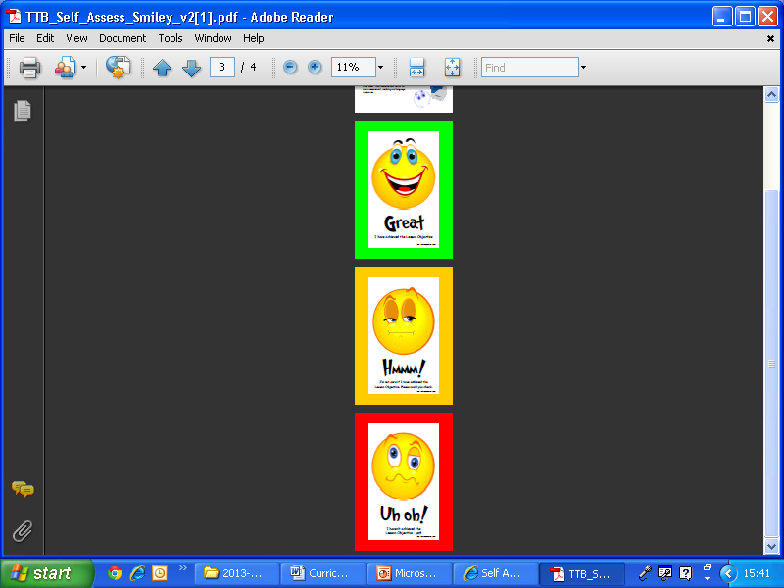


Assessment for Learning
Notes:
Include PTE PTM

Slide 4

Pastoral Care and General Information
School Ethos
Grow in Love
School / class rules
Positive Behaviour Policy
Rewards; Whole-School House System, Star of the Week, Pupil of the Month, Home/ School Communication
We promote self-regulation and awareness of the emotions of ourselves and others

Slide 5


Slide 6
Numeracy and Using Mathematics
Number
Shape and space
Data Handling
Measures
Skills – Problem solving

Slide 7
Mental Maths
New focus every Monday
Daily short sessions of ten minutes
Variety of fun activities
Singing songs and rhymes
Number fans, finger flash
Class quiz on Friday

Slide 8
  Number:
  100 square, number patterns and sequences
  Rounding to the nearest 10
  Place value to 20, 50, 100
  Addition, subtraction, introduction to multiplication and division
  Money- addition and subtraction within 50p / £1
  Measures, Shape and Space
  Time: hour, half hour, quarter to, quarter past and minutes on analogue and digital clocks
  2Dshape and their properties: circle, square, rectangle, triangle, pentagon and hexagon
  3D shapes and their properties
  Making shape patterns, symmetry, tessellation; Capacity/Weight/Length – introduction to standard measures
Numeracy

Slide 9
Numeracy
Data-handling
Record and interpret data from simple bar graphs
Carroll/Venn Diagrams
Processes/Investigations
Focusing on developing mental maths skills
Applying skills to problem-solving activities
Understanding word problems.

Slide 10
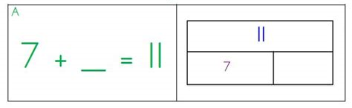
Problem-solving
An important part of Numeracy is equipping children with the strategies they need to solve problems
We are looking at bar modelling as one approach
In the bar model method, the children develop understanding from handling actual objects to drawing pictures and then they draw rectangles to represent these objects.
Other strategies for solving problems:
  Make an organised list Make a table Draw a picture

Slide 11
Practical ways to help your child
Homework
Number stories eg. to 10 : 7+3=10, 3+7=10
Use fingers, counters, number lines, hundred squares to help with calculations
Ordering numbers
Number patterns
Use known facts to find new facts eg. 5+2=7 so 15+2=17
Encourage use of number strategies eg. add by counting from the larger number (4+20)
Subtract by counting from the smaller number (19-17=2) or counting back from the larger number (19-1=18)
Add two digit numbers by partitioning (17+12=10+10+7+2)
Real life situations eg. shopping, reading the clock at home
Numeracy

Slide 12
Language and Literacy
Communication
Communication is a Cross Curricular skill which is integral to the whole curriculum. Requirements are:
Talking and listening
Reading (including phonics)
Writing

Slide 13


Talking and Listening
Show understanding with an appropriate response
Develop focus and listen for specific information
Listen for information
Listen with increasing concentration and take turns when speaking and offering opinions
Ask questions (why, where, how, when etc.)
Respond to questions appropriately
Build and expand vocabulary
Explain ideas and opinions with increasing clarity
Use of thinking time and talking partners
Role play activities – assuming a variety of roles
Circle Time
Show and Tell
Talk Partners
Thinking time
Class Discussions
Class Visitors
Class trips

Slide 14

Reading at home
Reading for enjoyment! Read a wide range of genre; fiction, non-fiction, poetry, recipes etc. Reading to and with your child.
Visit websites www.starfall.com, www.topmarks.co.uk, www.bbc.co.uk/schools/magickey, www.myonlinereading.com www.roythezebra.com, Oxford Owl
Visit the local library!
Building confidence with familiar reads. Developing sight vocabulary and fluency
Development of Reading Skills: Recall the story, sequence the story, answering questions/ comprehension, locate information in the text, make predictions, give and justify opinions, discuss characters.

Slide 15
Reading at home
Identifying punctuation and features of text; bold type, exclamation marks, question marks, speech bubbles, think bubbles etc.
Discussion of cover/ blurb/ title page
Encourage directionality when reading
Reading with expression
Decoding unfamiliar words
segmenting and blending sounds, using picture cues, read on for meaning, looking for words within words
Features of non fiction
new vocabulary, use of index and contents page, discussion of diagrams, labels
Revise familiar
words & Sounds
word hunt for tricky/
high frequency words
Word hunt for sounds
and rhyme patterns

Slide 16

Phonics
Revision P2 sounds
Development of vowel sounds – alternative spellings eg. ee/ea
Long and short vowel sounds
Target sound each week – linked to spellings
Focus on practical as well as written work eg. cut and stick activities, phonics cubes, play dough, tracing in sand, rainbow writing
Tricky words
A tool for reading, writing and spelling
Developing independence

Slide 17

Writing
Modelled - Guided - Independent
Progress writing sentences with correct punctuation and interesting vocabulary
Letter formation – Handwriting scheme Penpals
Children should talk about and plan what they are going to write. Use structured writing frames
Encourage independence: begin to check their work for spaces, capital letters etc. Learn to edit!
Write for a variety of purposes– recipes, stories, labelling diagrams etc.
Use a variety of skills to spell words in their writing (phonics, familiar word endings, use of word wall)
Spell familiar, important and regularly occurring words correctly. Make attempts to sound out other words.

Slide 18
Using ICT
Key Focus:
5 E’s - Explore, Express, Exchange, Exhibit, Evaluate
Keyboard skills
Word Processing
Paint/draw graphics
Use of digital camera, iPad
Using email
Coding eg: Scratch, Code.org

Slide 19
ICT at home
Word processing – practise typing name for logging on
Mouse control
Letting children select file, print, save to allow children to become familiar with the process and symbols
Useful websites:
www.primarygames.co.uk
www.topmarks.co.uk
www.ictgames.com
Tech homework each week

Slide 20
World Around Us
Theme based approach
Learning through play
Term 1: Our world/Whatever the Weather
Term 2: Space/Travel
Term 3: Minibeasts

Slide 21
Activity Based Learning
Springboard for learning
Cross-curricular
Broad and balanced
Themes/topics
Resources
Outdoor learning

Slide 22

Personal Development and Mutual Understanding
Self esteem
Feelings and emotions
Cultural diversity
Dispositions and attitudes
Similarities/ differences
Health and safety
School Rules
Relationship
Responsibilities

Slide 23


Religion
Grow in Love
I am special
Child’s experience starting point
Respect for others
Prayers
Homework/ Parental involvement

Slide 24
Physical Education
PE kit and shoes to be worn into school on PE days (Term1: P3KR Tuesday/Thursday
P3EL Tuesday/Thursday)
Co-ordination / Fundamental Skills
Primary Movement/Games/Dance

Slide 25
Our School Day
Ends 3pm Monday to Thursday; 1.45pm on Fridays
School car park – reverse park
Absences – phone call or email please – voicemail system
Register must be marked with ‘Unauthorised Absent’ if we have no formal communication from parents about a school absence
Dinner money (£2.60) book online using ‘School Money’ – must be done before midnight the evening previously

Slide 26
Seesaw App
Seesaw is a platform that enables teachers to share the child's learning journey with the parents/carers.
It can be used to inspire children of all ages to do their best.
When photographs/work are shared with parents/carers, it may provide an opportunity for the adult and child to discuss what is happening in school.
Communications on Seesaw should be treated confidentially and should not be shared on any other platforms.
If you need to contact the teacher, you can send a written note in with your child or email the office and this will passed on.

Slide 27
Information for parents
Encourage child and help develop independence
Supervise/SIGN homework – 20-30 mins (own work)
Full uniform, black shoes, PE uniform – on PE days (clubs)
Label all belongings (esp jumpers and cardigans)
Healthy break, water bottle – with ‘no leak’ lid
Up-to-date information eg. mobile no, email address (office)
Allergy information – medicines to office
Sign out of office for medical/dental appointments
PTA – new members most welcome
Notes:
PE uniform on day of PE
No jewellery – exception of stud earrings
Mobile phones – agreement form must be signed in office

Slide 28

Dates for your diary:
Sacrament of Reconciliation
P3KR: 19th March 4pm St Bernard’s
P3EL: 20th March 4pm St Bernard’s
Shared Education
Forest school dates see Google Form

